Slide 1
Lecture 3
Exception Handling

Slide 2
Exception-Handling Fundamentals
An exception is an abnormal condition that arises in a code sequence at run time
A Java exception is an object that describes an exceptional condition that has occurred in a piece of code
When an exceptional condition arises, an object representing that exception is created and thrown in the method that caused the error
An exception can be caught to handle it or pass it on
Exceptions can be generated by the Java run-time system, or they can be manually generated by your code

Slide 3
Exception-Handling Fundamentals
Java exception handling is managed by via five keywords: try, catch, throw, throws, and finally
Program statements to monitor are contained within a try block
If an exception occurs within the try block, it is thrown
Code within catch block catch the exception and handle it
System generated exceptions are automatically thrown by the Java run-time system
To manually throw an exception, use the keyword throw
Any exception that is thrown out of a method must be specified as such by a throws clause

Slide 4
Exception-Handling Fundamentals
Any code that absolutely must be executed before a method returns is put in a finally block
General form of an exception-handling block
try{
// block of code to monitor for errors
}
catch (ExceptionType1 exOb){
// exception handler for ExceptionType1
}
catch (ExceptionType2 exOb){
// exception handler for ExceptionType2
}
//…
finally{
// block of code to be executed before try block ends
}

Slide 5
Attendance Question 1
Is it possible for the following method to result in an exception?
// pre: word != null
public static void printLength(String word){
String output = "Word length is " + word.length();
System.out.println( output );
}
A. Yes
B. No

Slide 6
Exception Types
All exception types are subclasses of the built-in class Throwable in java.lang package.
Throwable has two subclasses, they are
  Exception (to handle exceptional conditions that user programs should catch)
    An important subclass of Exception is RuntimeException, that includes division by zero and invalid array indexing
  Error (to handle exceptional conditions that are not expected to be caught under normal circumstances). i.e. stack overflow

Slide 7

Exception -Class Hierarchy

Slide 8
Exception
Error
  Class Exception and its subclasses represent exception situations that can occur in a Java program and that can be caught by the application.
  So, generally reasonable applications should catch
  Array index out of bounds
  Arithmetic errors (divide by zero)
  Null Pointer Exception
  I/O Exceptions
  See the Java API Specification for more.
  Class Error and its subclasses represent abnormal situations that could happen in the JVM – it is usually not possible for a program to recover from Errors.
  So, generally you should NOT catch these.
  Virtual Machine Error
  out of memory
  stack overflow
  Thread Death
  Linkage Error

Slide 9
Uncaught Exceptions
If an exception is not caught by user program, then execution of the program stops and it is caught by the default handler provided by the Java run-time system
Default handler prints a stack trace from the point at which the exception occurred, and terminates the program
Ex:
class Exc0 {
public static void main(String args[]) {
int d = 0;
int a = 42 / d;
}
}
Output:
java.lang.ArithmeticException: / by zero
at Exc0.main(Exc0.java:4)
Exception in thread "main"
at Class.MethodName(filename:line no)

Slide 10
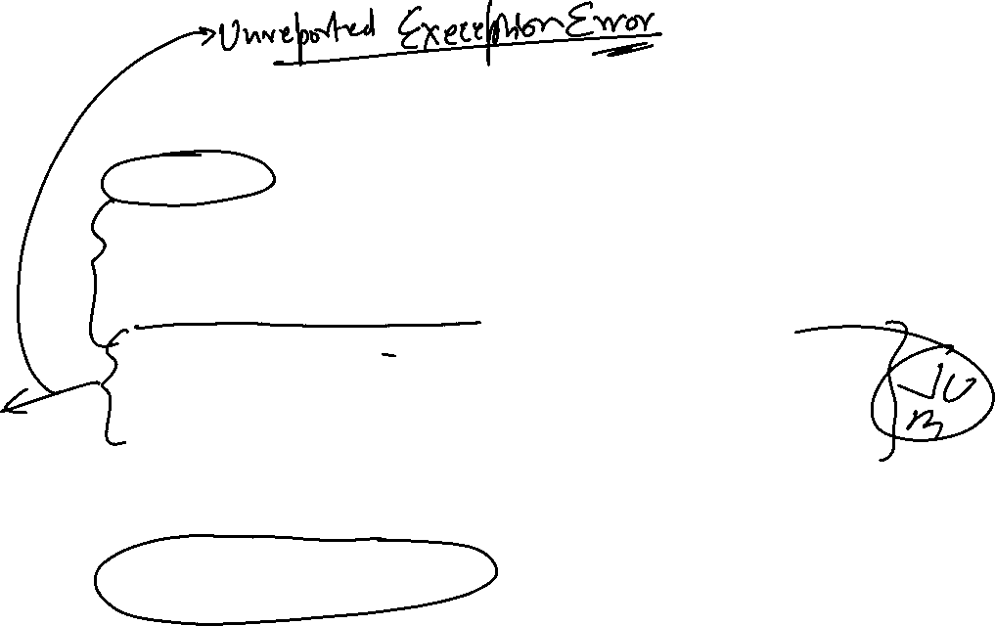
Exceptions -Checked and Unchecked
Checked.
If your code invokes a method which is defined to throw checked exception, your code MUST provide a catch handler
The compiler generates an error if the appropriate catch handler is not present
Any Sub Class belonging to Exception EXCEPT RuntimeException
e.g. FileNotFoundException and IOException
Unchecked
These exceptions can occur through normal operation of the virtual machine. You can choose to catch them or not.
If an unchecked exception is not caught, it will go to the default catch-all handler for the application
All Unchecked exceptions are subclassed from RuntimeException
e.g.NullPointerException and IndexOutOfBoundsException

Slide 11
Using try and catch
Handling an exception has two benefits,
  It allows you to fix the error
  It prevents the program from automatically terminating
The catch clause should follow immediately the try block
Once an exception is thrown, program control transfer out of the try block into the catch block
Once the catch statement has executed, program control continues with the next line in the program following the entire try/catch mechanism

Slide 12
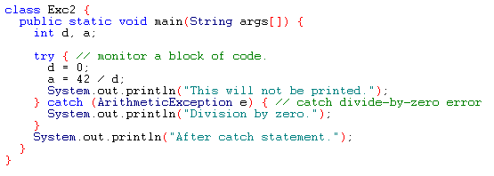
Example
Output:
Division by zero.
After catch statement.

Slide 13
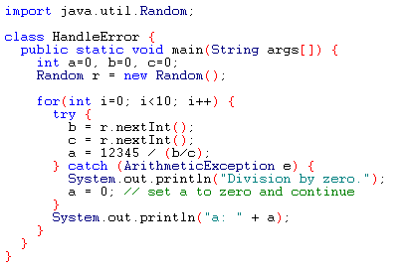
Using try and catch
A try and catch statement form a unit. The scope of the catch clause is restricted to those statements specified by the immediately preceding try statement
You cannot use try on a single statement

Slide 14
Attendance Question 2
What is output by the method badUse if it is called with the following code?
int[ ] nums = {3, 2, 6, 1};
badUse( nums );
public static void badUse(int[ ] vals)
{ int total = 0;
try{
for(int i = 0; i < vals.length; i++){
int index = vals[i];
total += vals[index];
}
}
catch(Exception e){
total = -1;
}
System.out.println(total);
}
A. 1 B. 0 C. 3 D. -1 E. 5

Slide 15
Multiple catch Clauses
If more than one can occur, then we use multiple catch clauses
When an exception is thrown, each catch statement is inspected in order, and the first one whose type matches that of the exception is executed
After one catch statement executes, the others are bypassed

Slide 16
Sequence of Events for throw
Preceding step
try block
throw statement
unmatched catch
matching catch
unmatched catch
next step

Slide 17
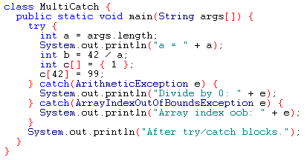
Example

Slide 18
Example (Cont.)
If no command line argument is provided, then you will see the following output:
  a = 0
  Divide by 0: java.lang.ArithmeticException: / by zero
  After try/catch blocks
If any command line argument is provided, then you will see the following output:
  a = 1
  Array index oob: java.lang.ArrayIndexOutOfBoundsException
  After try/catch blocks.

Slide 19
Caution
Remember that, exception subclass must come before any of of their superclasses
Because, a catch statement that uses a superclass will catch exceptions of that type plus any of its subclasses. So, the subclass would never be reached if it come after its superclass
For example, ArithmeticException is a subclass of Exception
Moreover, unreachable code in Java generates error

Slide 20
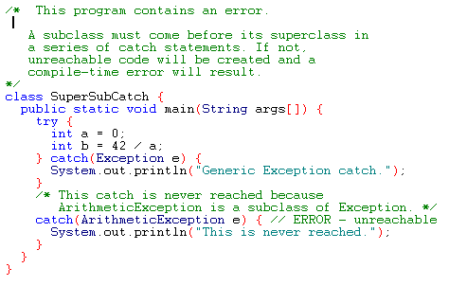
Example

Slide 21
Exception -The catch-all Handler
Since all Exception classes are a subclass of the Exception class, a catch handler which catches "Exception" will catch all exceptions.
It must be the last in the catch List
public void method1()
{
FileInputStream aFile;
try
{
aFile = new FileInputStream(...);
int aChar = aFile.read();
//...
}
catch(IOException x)
{
// ...
}
catch(Exception x)
{
// Catch All Exceptions

Slide 22
Nested try Statements
A try statement can be inside the block of another try
Each time a try statement is entered, the context of that exception is pushed on the stack
If an inner try statement does not have a catch, then the next try statement’s catch handlers are inspected for a match
Until one of catch succeeds or all of the nested try are exhausted else JVM will handle.
If a method call within a try block has try block within it, then then it is still nested try

Slide 23
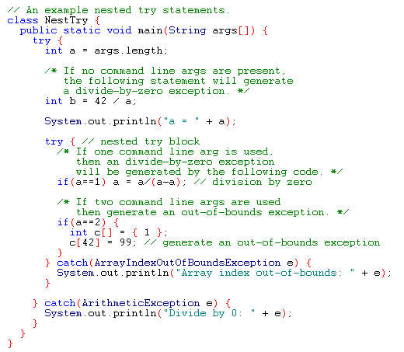
Example

Slide 24
Output
When no parameter is given:
  Divide by 0: java.lang.ArithmeticException: / by zero
When one parameter is given
a = 1
Divide by 0: java.lang.ArithmeticException: / by zero
When two parameters are given
  a = 2
  Array index out-of-bounds: java.lang.ArrayIndexOutOfBoundsException

Slide 25
throw
It is possible for your program to to throw an exception explicitly
throw TrrowableInstance
Here, TrrowableInstance must be an object of type Throwable or a subclass Throwable
There are two ways to obtain a Throwable objects:
  Using a parameter into a catch clause
  Creating one with the new operator

Slide 26
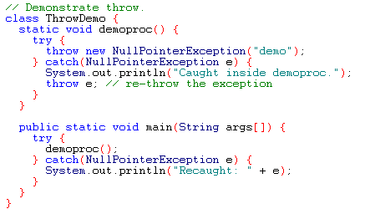
Example
Output:
Caught inside demoproc.
Recaught: java.lang.NullPointerException: demo

Slide 27
throws
If a method is capable of causing an exception that it does not handle, it must specify this behavior so that callers of the method can guard themselves against that exception
  type method-name parameter-list) throws exception-list
  {
  // body of method
  }
It is not applicable for Error or RuntimeException, or any of their subclasses.
Java’s checked Exceptions must be included in throws list of a method.

Slide 28
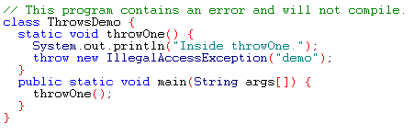
Example: incorrect program

Slide 29
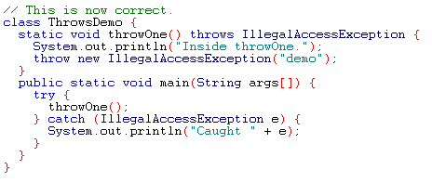
Example: corrected version
Output:
Inside throwOne.
Caught java.lang.IllegalAccessException: demo

Slide 30
finally Block
Consists of finally keyword followed by a block of code enclosed in curly braces
Optional in a try statement
If present, is placed after the last catch block
finally creates a block of code that will be executed after try/catch block has completed and before the code following the try/catch block
finally clause will execute whether or not an exception is thrown
It is used to handle premature execution of a method (i.e. a method open a file upon entry and closes it upon exit)
Typically contains resource-release code
Will not execute if the application exits early from a try block via method System.exit

Slide 31
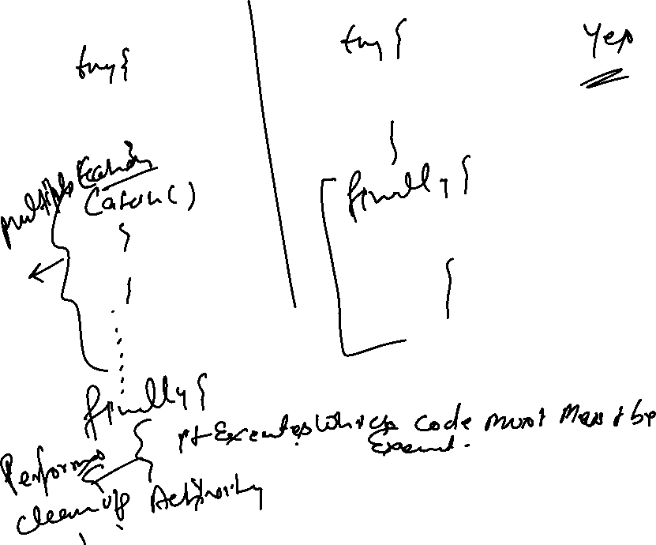

Slide 32
finally Block
Consists of finally keyword followed by a block of code enclosed in curly braces
Optional in a try statement
If present, is placed after the last catch block
finally creates a block of code that will be executed after try/catch block has completed and before the code following the try/catch block
finally clause will execute whether or not an exception is thrown
It is used to handle premature execution of a method (i.e. a method open a file upon entry and closes it upon exit)
Typically contains resource-release code
Will not execute if the application exits early from a try block via method System.exit

Slide 33
Using finally
Note
  Re-throw of exception
  Code for throw exception
  Blocks using finally
Suggestion
  Do not use a try block for every individual statement which may cause a problem
  Enclose groups of statements
  Follow by multiple catch blocks

Slide 34
Sequence of Events for finally clause
Preceding step
Preceding step
Preceding step
try block
throw statement
try block
throw statement
try block
throw statement
unmatched catch
unmatched catch
Unmatched catch
matching catch
unmatched catch
finally
finally
finally
next step
next step
next step

Slide 35
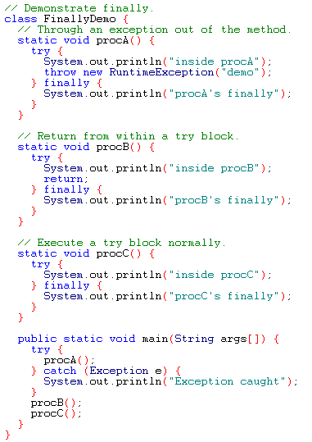
Example

Slide 36
Output
inside procA
procA's finally
Exception caught
inside procB
procB's finally
inside procC
procC's finally

Slide 37

Checked Exceptions
/* Program to read two integers Display their sum */
import java.io.*;
class Exceptiondemo3
{
public static void main(String args[])
{
BufferedReader br = new BufferedReader(new InputStreamReader(System.in));
int a = Integer.parseInt(br.readLine());
int b = Integer.parseInt(br.readLine());
System.out.println("Sum is :"+(a+b));
}
}
WILL THIS CODE COMPILE SUCCESSFULLY ?
Exceptiondemo3.java:9: unreported exception java.io.IOException; must be caught or declared to be thrown
int a = Integer.parseInt(br.readLine()); ^
Exceptiondemo3.java:10: unreported exception java.io.IOException; must be caugh or declared to be thrown
int b = Integer.parseInt(br.readLine()); ^

Slide 38
Ways To Handle Checked Exceptions
Method 1: << Mention thru throws clause>>
import java.io.*;
class Exceptiondemo3
{
public static void main(String args[]) throws IOException
{
BufferedReader br = new BufferedReader(new inputStreamReader(System.in));
int a = Integer.parseInt(br.readLine());
int b = Integer.parseInt(br.readLine());
System.out.println("Sum is :"+(a+b));
}
}
throws clause is used with methods to indicate type of Exception a method can throw
Specifically required for Checked Exceptions [ To Pass Compilation process]. It can/may be used for unchecked exceptions also.
A method can throw as many exceptions.

Slide 39
Ways To Handle Checked Exceptions cont….
Method 2 << Put the statements in try catch block and catch >>
import java.io.*;
class Exceptiondemo3
{
public static void main(String args[])
{
BufferedReader br = new BufferedReader(new inputStreamReader(System.in));
try {
int a = Integer.parseInt(br.readLine());
int b = Integer.parseInt(br.readLine());
System.out.println("Sum is :"+(a+b));
}
catch(IOException e) { }
}
}

Slide 40
Trace a Program Execution
animation
Suppose no exceptions in the statements
try {
statements;
}
catch(TheException ex) {
handling ex;
}
finally {
finalStatements;
}
Next statement;

Slide 41
Trace a Program Execution
animation
The final block is always executed
try {
statements;
}
catch(TheException ex) {
handling ex;
}
finally {
finalStatements;
}
Next statement;

Slide 42
Trace a Program Execution
Next statement in the method is executed
try {
statements;
}
catch(TheException ex) {
handling ex;
}
finally {
finalStatements;
}
Next statement;

Slide 43
Trace a Program Execution
animation
try {
statement1;
statement2;
statement3;
}
catch(Exception1 ex) {
handling ex;
}
finally {
finalStatements;
}
Next statement;
Suppose an exception of type Exception1 is thrown in statement2

Slide 44
Trace a Program Execution
animation
try {
statement1;
statement2;
statement3;
}
catch(Exception1 ex) {
handling ex;
}
finally {
finalStatements;
}
Next statement;
The exception is handled.

Slide 45
Trace a Program Execution
animation
try {
statement1;
statement2;
statement3;
}
catch(Exception1 ex) {
handling ex;
}
finally {
finalStatements;
}
Next statement;
The final block is always executed.

Slide 46
Trace a Program Execution
animation
try {
statement1;
statement2;
statement3;
}
catch(Exception1 ex) {
handling ex;
}
finally {
finalStatements;
}
Next statement;
The next statement in the method is now executed.

Slide 47
Trace a Program Execution
animation
try {
statement1;
statement2;
statement3;
}
catch(Exception1 ex) {
handling ex;
}
catch(Exception2 ex) {
handling ex;
throw ex;
}
finally {
finalStatements;
}
Next statement;
statement2 throws an exception of type Exception2.

Slide 48
Trace a Program Execution
animation
try {
statement1;
statement2;
statement3;
}
catch(Exception1 ex) {
handling ex;
}
catch(Exception2 ex) {
handling ex;
throw ex;
}
finally {
finalStatements;
}
Next statement;
Handling exception

Slide 49
Trace a Program Execution
animation
try {
statement1;
statement2;
statement3;
}
catch(Exception1 ex) {
handling ex;
}
catch(Exception2 ex) {
handling ex;
throw ex;
}
finally {
finalStatements;
}
Next statement;
Execute the final block

Slide 50
Trace a Program Execution
animation
try {
statement1;
statement2;
statement3;
}
catch(Exception1 ex) {
handling ex;
}
catch(Exception2 ex) {
handling ex;
throw ex;
}
finally {
finalStatements;
}
Next statement;
Rethrow the exception and control is transferred to the caller

Slide 51
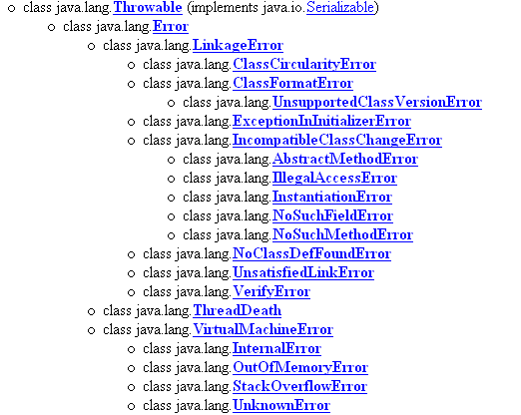
Java’s Built-in Errors
Small letter indicate package name
Capital letter indicate class name

Slide 52
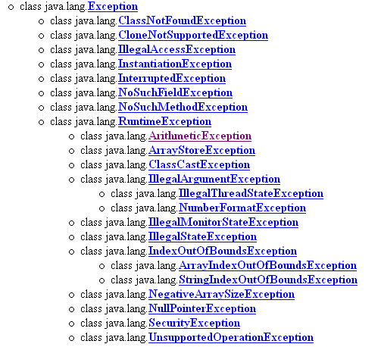
Java’s Built-in Exceptions

Slide 53

Exceptions -throwing multiple exceptions
A Method can throw multiple exceptions.
Multiple exceptions are separated by commas after the throws keyword:
public class MyClass
{
public int computeFileSize()
throws IOException, ArithmeticException
[...]
public void method1()
{
MyClass anObject = new MyClass();
try
{
int theSize = anObject.computeFileSize();
}
catch(ArithmeticException x)
{
// ...
}
catch(IOException x)
{
// ...

Slide 54
I/O Exceptions
Let's examine issues related to exceptions and I/O
A stream is a sequence of bytes that flow from a source to a destination
In a program, we read information from an input stream and write information to an output stream
A program can manage multiple streams simultaneously

Slide 55
Standard I/O
There are three standard I/O streams:
  standard output – defined by System.out
  standard input – defined by System.in
  standard error – defined by System.err
We use System.out when we execute println statements
System.out and System.err typically represent a particular window on the monitor screen
System.in typically represents keyboard input, which we've used many times with Scanner objects

Slide 56
The IOException Class
Operations performed by some I/O classes may throw an IOException
  A file might not exist
  Even if the file exists, a program may not be able to find it
  The file might not contain the kind of data we expect
An IOException is a checked exception

Slide 57
Writing Text Files
In Chapter 5 we explored the use of the Scanner class to read input from a text file
Let's now examine other classes that let us write data to a text file
The FileWriter class represents a text output file, but with minimal support for manipulating data
Therefore, we also rely on PrintStream objects, which have print and println methods defined for them

Slide 58
Writing Text Files
Finally, we'll also use the PrintWriter class for advanced internationalization and error checking
We build the class that represents the output file by combining these classes appropriately
See TestData.java (page 547)
Output streams should be closed explicitly

Slide 59
Defining Your Own Exceptions
To define your own exception you must do the following:
Create an exception class to hold the exception data.
Your exception class must subclass "Exception" or any other exception class
Note: to create unchecked exceptions, subclass the RuntimeException class.
Minimally, your exception class should provide a constructor which takes the exception description as its argument.
class AException extends Exception { …} // Checked Exception
class BException extends IOException { ..} //Checked Exception
class XException extends RunTimeException { … } // Unchecked Exception
class YException extends AritmeticException { … } // Unchecked Exception
To throw your own exceptions:
If your exception is checked, any method which is going to throw the exception must define it using the throws keyword
When an exceptional condition occurs, create a new instance of the exception and throw it.

Slide 60
Throwing Unchecked Exception
Create an InvalidBOXException which will be thrown by the constructor of the BOX class whenever an attempt will be made to create an invalid BOX object. (Any Dimension = 0 or < 0).
Create an InvalidTriangleException which will be thrown whenever an attempt will be made to create an invalid Triangle object. (In Triangle sum of two sides must be > third side).

Slide 61
EXAMPLE 1:
class InvalidBOXException extends RuntimeException
{
InvalidBOXException(String msg)
{
super(msg);
System.out.println("An attempt is made to create an Invalid BOx object ");
}
}
class BOX
{
private double length;
private double width;
private double height;
BOX(double l, double w, double h)
{
if( l <=0 || w <= 0 || h <= 0)
throw new InvalidBOXException("Invalid BOX Object creation");
length = l;
width = w;
height = h;
}
Optional as InvalidBOXException is Unchecked
throws InvalidBOXException

Slide 62
double getLength() { return length; }
double getWidth() { return width; }
double getHeight() { return height; }
double Area() { return 2*(length*width + width*height + height*length); }
double Volume() { return length*width*height ; }
}
class exceptiontest1
{
public static void main(String args[])
{
BOX b1 = new BOX(0,0,0);
BOX b2 = new BOX(10,4,5);
System.out.println(“Area of b2:”+b2.Area());
}
}
D:\java\bin>java exceptiontest1
An attempt is made to create an Invalid BOx object
Exception in thread "main" InvalidBOXException: Inavlid BOX Object creation
at BOX.<init>(exceptiontest1.java:18)
at exceptiontest1.main(exceptiontest1.java:35)

Slide 63
Change of main method No 1
class exceptiontest1
{
public static void main(String args[])
{
try {
BOX b1 = new BOX(0,0,0);
System.out.println("Area of b1"+b1.Area());
}
// catch(InvalidBOXException e) { }
catch(Exception e) { };
try {
BOX b2 = new BOX(10,4,5);
System.out.println("Area of b2:"+b2.Area());
}
// catch(InvalidBOXException e) { }
catch(Exception e) {};
}}
If these statements are out side try block?
D:\java\bin>java exceptiontest1
An attempt is made to create an Invalid BOx object
Area of b2:220.0

Slide 64
Change of Main Method No 2
class exceptiontest1
{
public static void main(String args[])
{
BOX b1;
System.out.println(b1.Area());
}
}
<Compile Time Error>
D:\java\bin>javac exceptiontest1.java
exceptiontest1.java:36: variable b1 might not have been initialized
System.out.println(b1.Area());
^
1 error
class exceptiontest1
{
public static void main(String args[])
{
BOX b1 = null;
System.out.println(b1.Area());
}
}
<RUNTIME Error>
D:\java\bin>java exceptiontest1
Exception in thread "main" java.lang.NullPointerException
at exceptiontest1.main(exceptiontest1.java:36)

Slide 65
Checked Exceptions
Make your exception class extends Exception class or any one of its subclass except RumtimeException.
Checked Exceptions needs to either caught or informed by use of throws clause
Note down that throw clause is used to throw the exception where as throws clause is used to inform that an exception is thrown by the method.
Throw clause is used inside method body where as throws clause is used with first line of the method.
Throws clause can be used to inform both type of exceptions. But in case a method is throwing a unchecked exception then it is not compulsory to inform.
In case a method is throwing a checked Exception, then it has either to caught the exception or informs by using throws clause or it can do both.

Slide 66
EXAMPLE 1:
class InvalidBOXException extends Exception
{
InvalidBOXException(String msg)
{
super(msg);
System.out.println("An attempt is made to create an Invalid BOx object ");
}
}
Checked Exception
class BOX
{
private double length;
private double width;
private double height;
BOX(double l, double w, double h)
{
if( l <=0 || w <= 0 || h <= 0)
throw new InvalidBOXException("Inavlid BOX Object creation");
length = l;
width = w;
height = h;
}
Any Method or constructor which throws an checked Type Exception must inform it thru throws clause

Slide 67
double getLength() { return length; }
double getWidth() { return width; }
double getHeight() { return height; }
double Area() { return 2*(length*width + width*height + height*length); }
double Volume() { return length*width*height ; }
}
class exceptiontest1
{
public static void main(String args[])
{
BOX b1 = new BOX(0,0,0);
BOX b2 = new BOX(10,4,5);
System.out.println(“Area of b2:”+b2.Area());
}
}
D:\java\bin>javac exceptiontest1.java < Compile Time Error>
exceptiontest1.java:18: unreported exception InvalidBOXException; must be caught or declared to be thrown throw new InvalidBOXException("Inavlid BOX Object creation");
^
1 error

Slide 68
EXAMPLE 1:
class InvalidBOXException extends Exception
{
InvalidBOXException(String msg)
{
super(msg);
System.out.println("An attempt is made to create an Invalid BOx object ");
}
}
class BOX
{
private double length;
private double width;
private double height;
BOX(double l, double w, double h) throws InvalidBOXException
{
if( l <=0 || w <= 0 || h <= 0)
throw new InvalidBOXException("Inavlid BOX Object creation");
length = l;
width = w;
height = h;
}

Slide 69
double getLength() { return length; }
double getWidth() { return width; }
double getHeight() { return height; }
double Area() { return 2*(length*width + width*height + height*length); }
double Volume() { return length*width*height ; }
}
class exceptiontest1
{
public static void main(String args[]) throws InvalidBOXException
{
BOX b1 = new BOX(0,0,0);
BOX b2 = new BOX(10,4,5);
System.out.println(“Area of b2:”+b2.Area());
}
}
D:\java\bin>java exceptiontest1
An attempt is made to create an Invalid BOx object
Exception in thread "main" InvalidBOXException: Inavlid BOX Object creation
at BOX.<init>(exceptiontest1.java:18)
at exceptiontest1.main(exceptiontest1.java:36)

